Slide 1
Advanced Mocking Techniques

Slide 2

Overview
More mock verification
Partial mocks
Dealing with code that is difficult to test

Slide 3


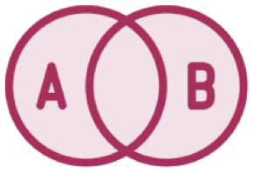
More Verification Tools
verifyNoMoreInteractions(mocks)
Called stubbed methods are also treated as interactions!
verifyNoMoreInteractions(ignoreStubs(mocks)) ignores stubs for the purposes of verification

Slide 4


Mockito Strictness: Default Modes
Mockito 2.X: WARN Complaints logged in console when
things are not ideal
Mockito 3: STRICT_STUBS
Enabling this mode explicitly in Mockito 2.X means ignoreStubs(…) is not necessary anymore

Slide 5

Demo
Verify no unexpected invocations on your mocks

Slide 6




Partial Mocks
You spy on real
objects
Use occasionally
Spies are partial mocks
When creating a spy, Mockito creates a copy of the object, it doesn’t delegate calls

Slide 7
Spies should only be used occasionally and come in useful when you find yourself in a situation with code that impossible, or too costly, to change

Slide 8
Demo
Creating spies
Using spies to test tricky situations

Slide 9



Solution One: The PowerMock Framework
Mockito cannot mock static methods, such as LocalDate.now()
This solution is useful when you can’t change the source code making static calls
https://github.c om/powermock
/powermock/wi ki/Mockito

Slide 10




Solution Two: Java’s Clock Class
Pluggable abstraction of time which simplifies tests
This solution is useful when you can change the source code making static calls
https://docs.ora cle.com/javase/ 8/docs/api/java
/time/Clock.htm l (since Java 1.8)
Let’s see this in action!

Slide 11
Demo
Testing code that deals with time

Slide 12



Mocking Final Methods
Mocking final classes and methods is now supported (since 2.1.0)
Final methods/classes can be mocked just like non-final ones
‘/mockito-extensions/org.mockito.plugins.MockMaker’ containing a single line: ‘mock-maker-inline’

Slide 13

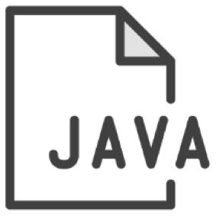

Selective Partial Mocks
You can turn a mock into a spy by selectively enabling real methods
SomeType spy = spy(SomeType.class);
SomeType mock = mock(SomeType.class); when(mock.someMethod).thenCallRealMethod();

Slide 14
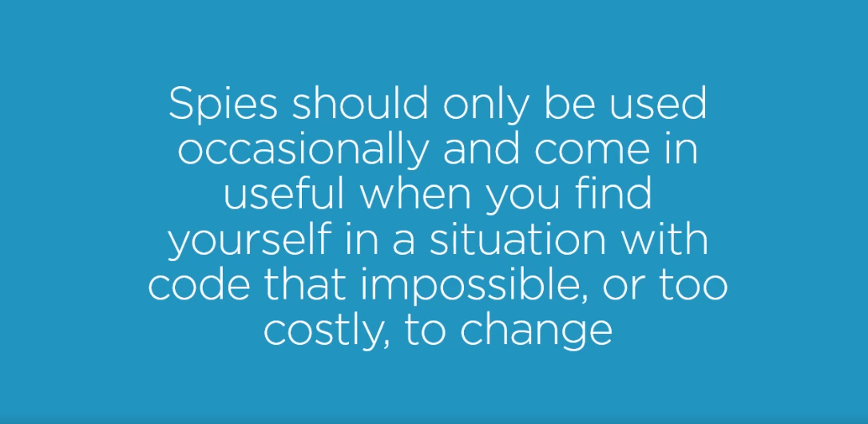

Slide 15
More verification toolkit
verifyNoMoreInteractions
verifyNoMoreInteractions(ignoreStubs (…)
Partial mocks (spies) Tested tricky scenarios
Summary

